Slide 1
Build a Progressive Web App (PWA) with Angular 16

Slide 3
What is PWA?
Requirements | Description
Responsive | Runs on almost every device desktop, mobile, or tablet.
Auto-Updated | Service worker keeps it always updated.
Secure | Content is considered to be safe due to serving through HTTPS.
Reliably Connected | Service workers support to make it work offline and on sparse networks.
Progressive | Web app that employs modern web capabilities to produce an app-like experience for every user.
Searchable | Searchable via search engines due to web app manifest.
Shareable | It does not require to be downloaded can easily be shared via a simple link or URL.
User Experience | Similar user experience by engaging the same interaction methodology as a native app has.
Installable | Fully installable on users’ mobile home screen, and the good thing is we do not have to visit the app store.

Slide 4

Demo
Angular 16 PWA (Progressive Web App)
Configuring & Installing Angular Application
Adding Angular Material Library
Build & Consume REST API using HttpClient
Adding PWA in Angular
Service Workers in Angular
Configure Production Build with http-server
Audit PWA App with Lighthouse
Conclusion

Slide 5
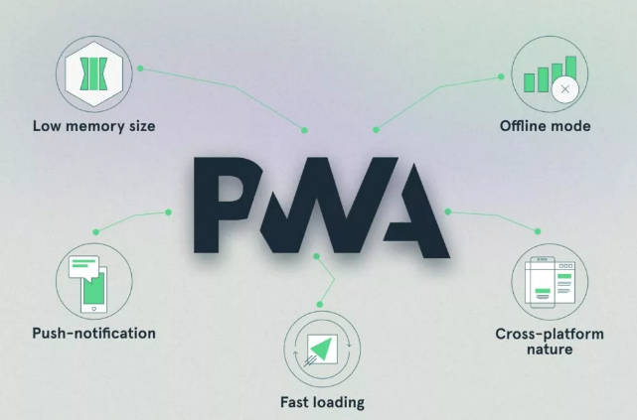
PWA Capabilities
Reference: https://learn.microsoft.com/en-us/microsoft-edge/progressive-web-apps-chromium/how-to/offline

Slide 6
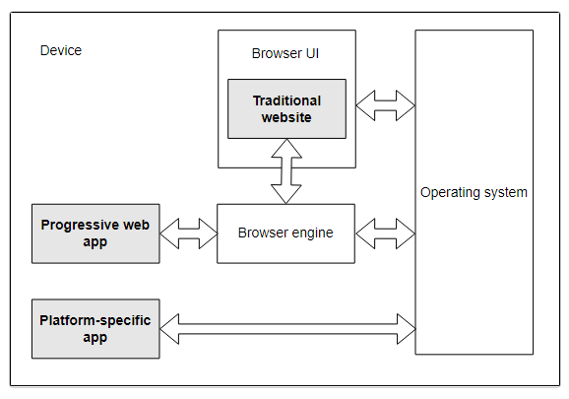
PWAs and the browser

Slide 7
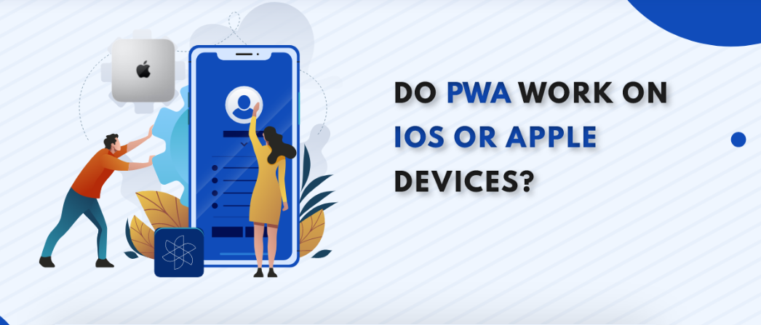
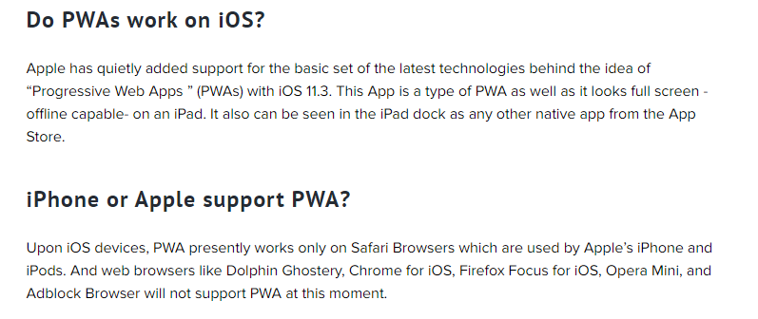

Slide 8
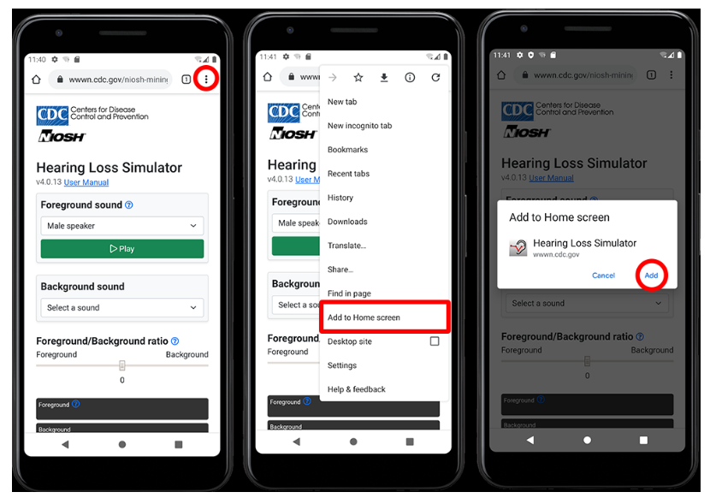
Installing a PWA on Android

